Slide 1
Chemical Equilibrium

Slide 2
Chemical Equilibrium
The reactions considered until now have had reactants react completely to form products. These reactions “went” only in one direction.
Some reactions can react in either direction. They are “reversible”. When this occurs some amount of reactant(s) will always remain in the final reaction mixture.

Slide 3
Chemical Equilibrium (Definitions)
A chemical system where the concentrations of reactants and products remain constant over time.
On the molecular level, the system is dynamic: The rate of change is the same in either the forward or reverse directions.

Slide 4
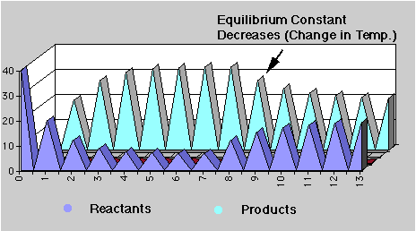
Dynamic Equilibrium “The Pennies”
http://chemconnections.org/general/chem120/equil-graph.html

Slide 5

Chemical Equilibrium
Consider
[Refer to the Equilibrium Worksheet.]
If the reaction begins with just A, as the reaction progresses:
[A] decreases to a constant concentration,
[B] increases from zero to a constant concentration.
When [A] and [B] are constant, equilibrium is reached.

Slide 6
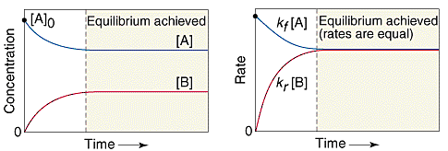
Chemical Equilibrium
Graphical Treatment of Rates & Changes
Rate of loss of A = -k_{f} [A]; decreases to a constant,
Rate of formation of B = k_{r} [B]; increases from zero to a constant.
When -k_{f} [A] = k_{r} [B] equilibrium is reached.

Slide 7
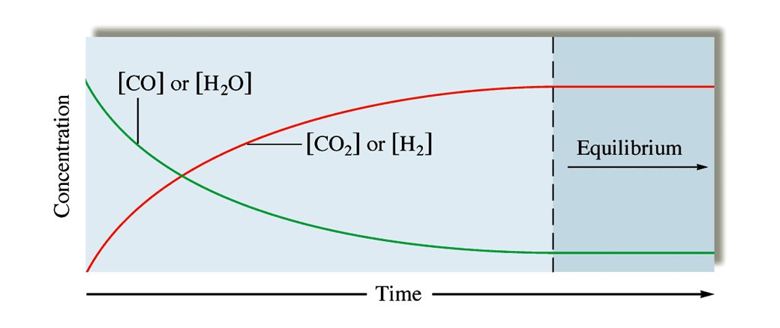
QUESTION
The changes in concentrations with time for the reaction H₂O(g) + CO(g)  H₂(g) + CO₂(g) are graphed below when equimolar quantities of H₂O(g) and CO(g) are mixed.
Which of the comments given here accurately apply to the concentration versus time graph for the H₂O + CO reaction?
A. The point where the two curves cross shows the concentrations of reactants and products at equilibrium.
B. The slopes of tangent lines to each curve at a specific time prior to reaching equilibrium are equal, but opposite, because the stoichiometry between the products and reactants is all 1:1.
C. Equilibrium is reached when the H₂O and CO curves (green) gets to the same level as the CO₂ and H₂ curves (red) begin.
D. The slopes of tangent lines to both curves at a particular time indicate that the reaction is fast and reaches equilibrium.
Notes:
HMClassPrep Figure 13.2

Slide 8
Answer
B) is the only statement that accurately comments on this graph. When the stoichiometry is not 1:1 the slopes of tangent lines to both curves at a particular time reflect the stoichiometry ratio of the reactants.

Slide 9
Chemical Equilibrium
Add nitrogen and hydrogen gases together in any proportions. Nothing noticeable occurs.
Add heat, pressure and a catalyst, you smell ammonia => a mixture with constant concentrations of N₂ , H₂ and NH₃ is produced.
Start with just ammonia and catalyst. N₂ and H₂ will be produced until a state of equilibrium is reached.
As before, a mixture with constant concentrations of nitrogen, hydrogen and ammonia is produced.

Slide 10
Chemical Equilibrium
No matter what the starting composition of reactants and products, the same ratio of concentrations is realized when equilibrium is reached at a certain temperature and pressure.

Slide 11
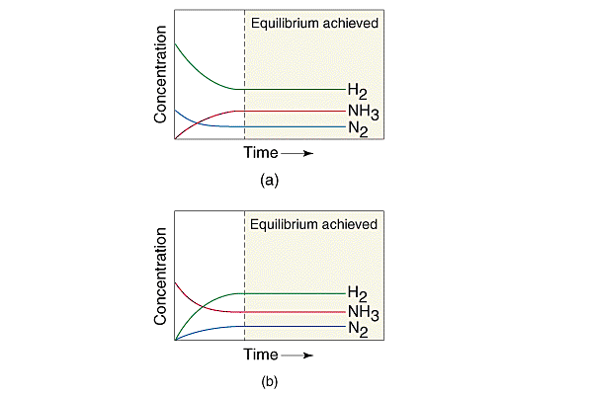
Chemical Equilibrium
The Previous Examples Graphically:

Slide 12
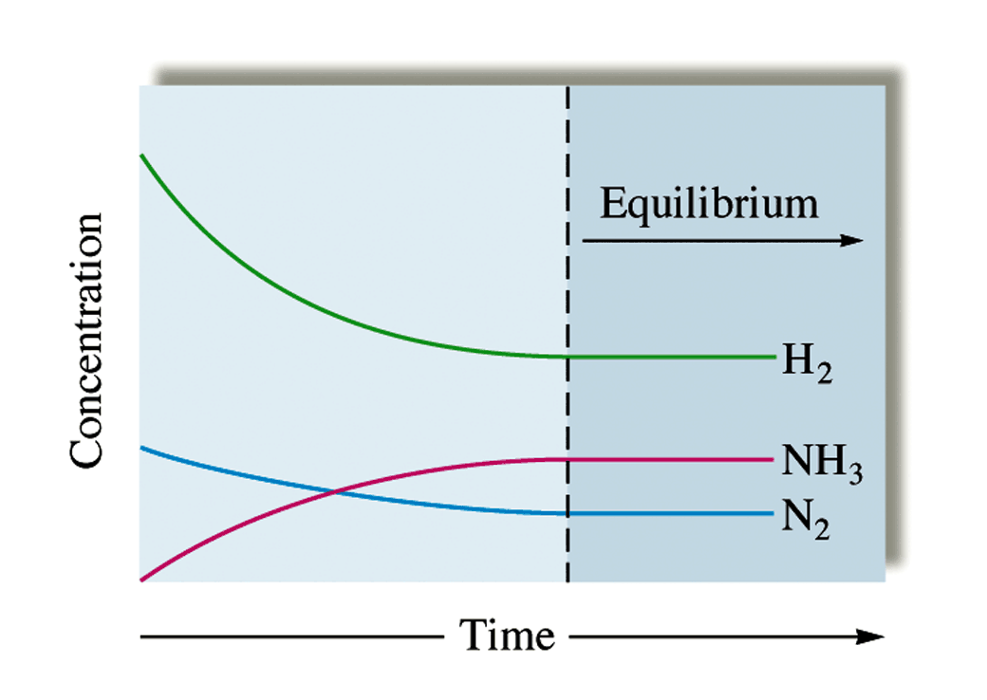
QUESTION
This is a concentration profile for the reaction N₂(g) + 3H₂(g)  2NH₃(g) when only N₂(g) and H₂(g) are mixed initially.
The figure shown here represents the concentration versus time relationship for the synthesis of ammonia (NH₃). Which of the following correctly interprets an observation of the system?
A. At equilibrium, the concentration of NH₃ remains constant even though some is also forming N₂ and H₂, because some N₂ and H₂ continues to form NH₃.
B The NH₃ curve (red) crosses the N₂ curve (blue) before reaching equilibrium because it is formed at a slower rate than N₂ rate of use.
C. All slopes of tangent lines become equal at equilibrium because the reaction began with no product (NH₃).
D. If the initial N₂ and H₂ concentrations were doubled from what is shown here, the final positions of those curves would be twice as high, but the NH₃ curve would be the same.
Notes:
HMClassPrep Figure 13.5

Slide 13
Answer
properly states the relationship between reactants and products in a system that has reached a dynamic equilibrium. At equilibrium, the rate of the forward reaction continues at a pace that is equal to the continued pace of the reverse reaction.

Slide 14
Law of Mass Action
(Equilibrium Expression)
For a reaction:
jA + kB ↔ lC + mD
The law of mass action is represented by the Equilibrium Expression: where K is the Equilibrium Constant. (Units for K will vary.)

Slide 15
QUESTION
One of the environmentally important reactions involved in acid rain production has the following equilibrium expression. From the expression, what would be the balanced chemical reaction?
Note: all components are in the gas phase.
K = [SO₃]/([SO₂][O₂]^{1/2})
SO₃(g)  SO₂(g) + 2O₂(g)
SO₃(g)  SO₂(g) + 1/2O₂(g)
SO₂(g) + 2O₂(g)  SO₃(g)
SO₂(g) + 1/2O₂(g)  SO₃(g)

Slide 16
Answer
D) properly shows the product SO₃ on the right and incorporates the previous exponents from the equilibrium expression as coefficients in the chemical equation.

Slide 17
Equilibrium Expression
4 NH₃(g) + 7 O₂(g) ↔ 4 NO₂(g) + 6 H₂O(g)
Write the Equilibrium Expression for the reaction. The expression will have either concentration units of mol/L (M), or units of pressure (atm) for the reactants and products. What would be the overall unit for K using Molarity and atm units respectively.
K’s units = M ⁻¹= L/mol or atm⁻¹

Slide 18
QUESTION
Starting with the initial concentrations of:
[NH₃] = 2.00 M; [N₂] = 2.00 M; [H₂] = 2.00 M,
what would you calculate as the equilibrium ratio once the equilibrium position is reached for the ammonia synthesis reaction?
N₂ + 3H₂  2NH₃
1.00
0.250
4.00
This cannot be done from the information provided.

Slide 19
Answer
D) is the correct response. The concentrations given are for the INITIAL position. In order to calculate the K ratio of products to reactants the equilibrium position concentrations must be observed.

Slide 20
Equilibrium Expressions
1) If a reaction is re-written where the reactants become products and products-reactants, the new Equilibrium Expression is the reciprocal of the old. K_{new} = 1 / K_{original}
2) When the entire equation for a reaction is multiplied by n, K_{new} = (K_{original})^{n}

Slide 21
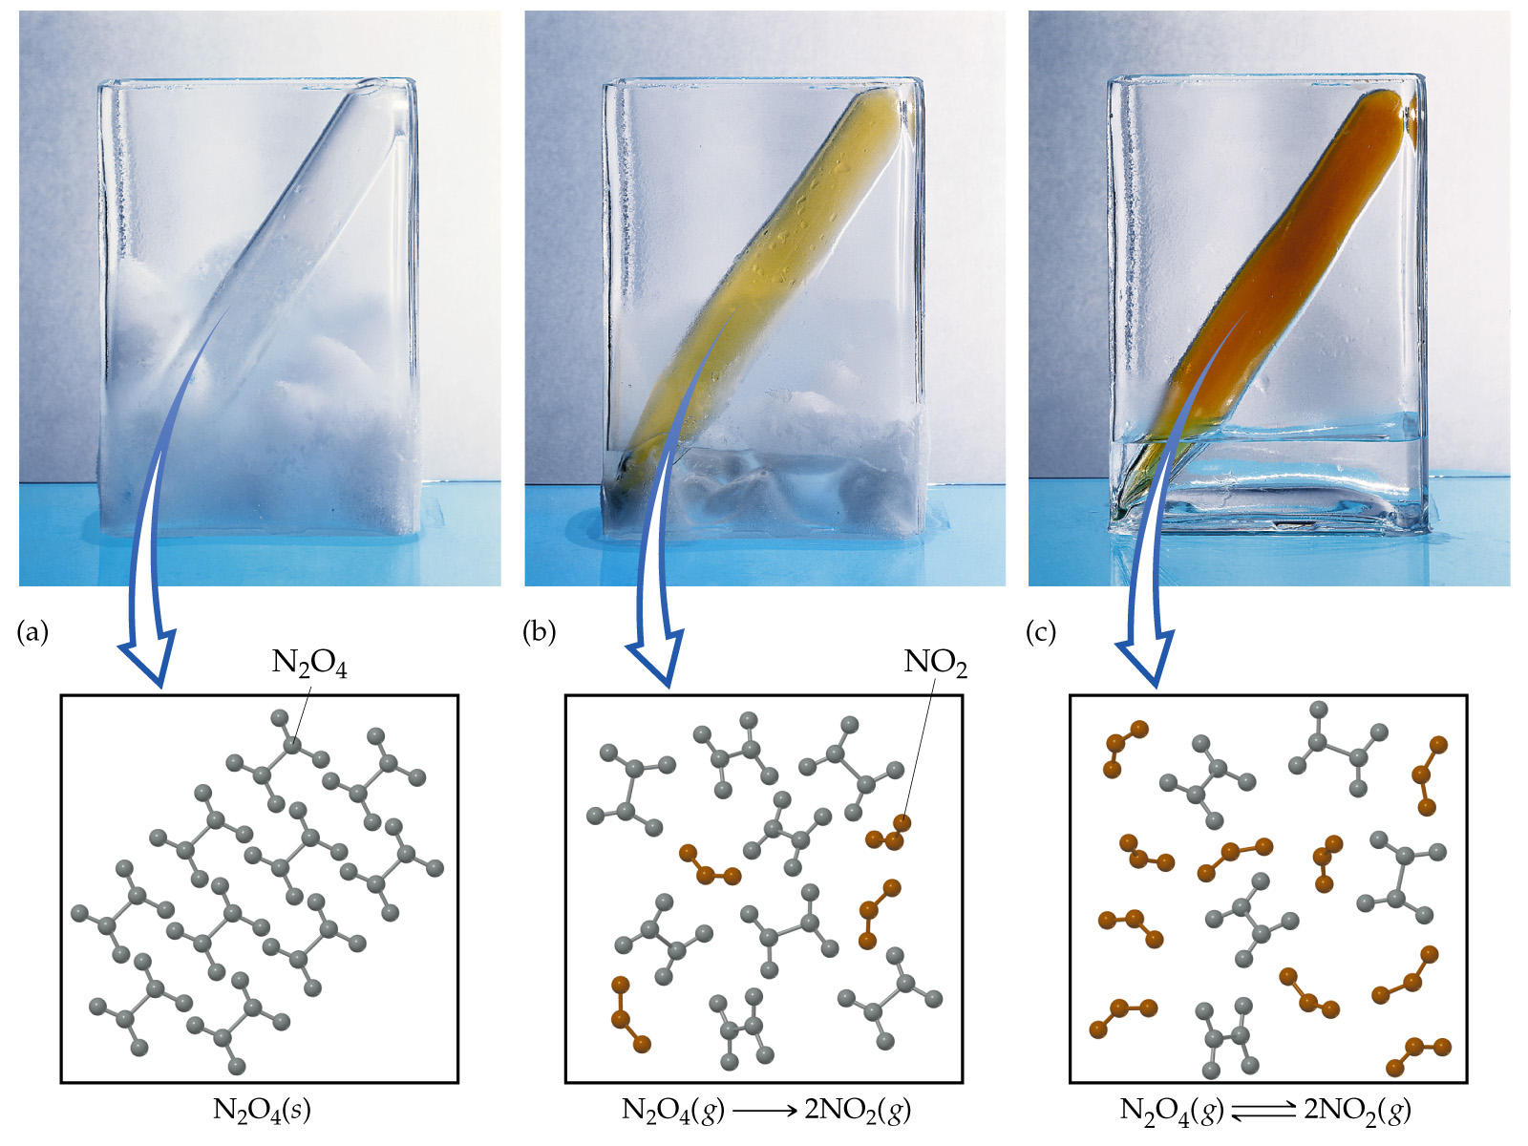
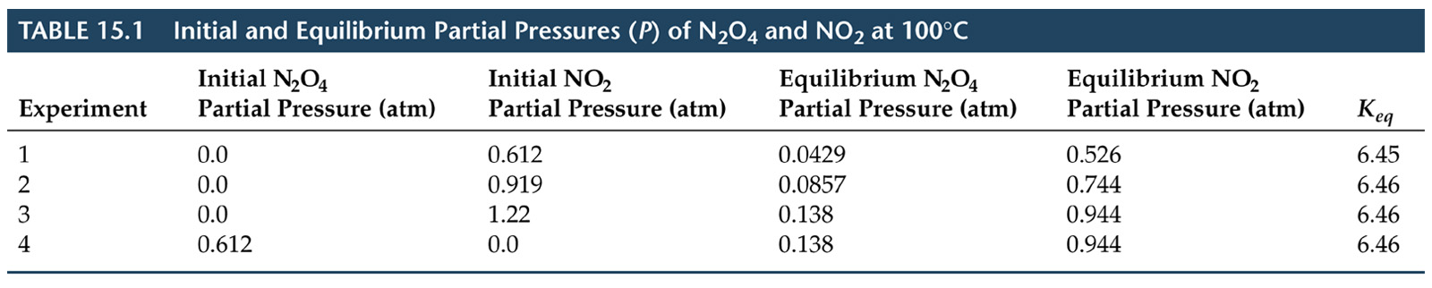
The Equilibrium Constant

Slide 22
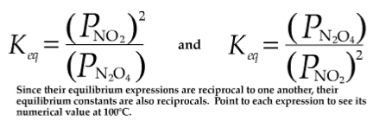
The Equilibrium Constant

Slide 23
The Equilibrium Constant

Slide 24
QUESTION
One of the primary components in the aroma of rotten eggs is H₂S. At a certain temperature, it will decompose via the following reaction.
2H₂S(g)  2H₂(g) + S₂(g)
If an equilibrium mixture of the gases contained the following pressures of the components, what would be the value of K_{p}?
PH₂S = 1.19 atm; PH₂ = 0.25 atm; PS₂ = 0.25 atm
0.011
91
0.052
0.013

Slide 25
ANSWER
provides the correct K_{p} value. Whether the equilibrium constant is based on pressure or molarity, the ratio is always set to show products divided by reactants. In addition, the pressure must be raised to the power that corresponds to the coefficients in the balanced equation.

Slide 26
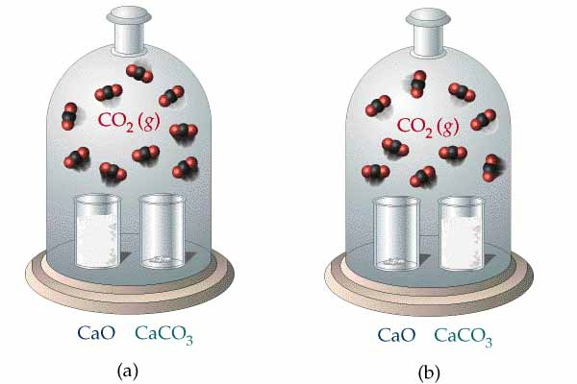
Heterogeneous Equilibrium
Notes:
Pure solids and liquids do not appear in the equilibrium expression since their concentration remains essentially constant. This is illustrated for the equilibrium between CaCO₃ and its decomposition products CaO and CO2. The number of molecules and consequently the pressure of CO₂ is the same in both bell jars even though the relative amounts of CaO and CaCO₃ are different.

Slide 27
Heterogeneous Equilibria
When all reactants and products are in one phase, the equilibrium is homogeneous.
If one or more reactants or products are in a different phase, the equilibrium is heterogeneous.
CaCO₃(s) ↔ CaO(s) + CO₂(g)
K = [CO₂]

Slide 28
Heterogeneous Equilibria
CaCO₃(s) ↔ CaO(s) + CO₂(g)
K = [CO₂]
Experimentally, the amount of CO₂ does not meaningfully depend on the amounts of CaO and CaCO₃.
The position of a heterogeneous equilibrium does not depend on the amounts of pure solids or liquids present.

Slide 29
QUESTION
The liquid metal mercury can be obtained from its ore cinnabar via the following reaction:
HgS(s) + O₂(g)  Hg(l) + SO₂(g)
Which of the following shows the proper expression for K_{c}?
K_{c} = [Hg][SO₂]/[HgS][O₂]
K_{c} = [SO₂]/[O₂]
K_{c} = [Hg][SO₂]/[O₂]
K_{c} = [O₂]/[SO₂]

Slide 30
Answer
B) correctly presents the product to reactant ratio. Recall that pure liquids and solids are not shown in the equilibrium constant expression.

Slide 31
QUESTION
At a certain temperature, FeO can react with CO to form Fe and CO₂. If the K_{p} value at that temperature was 0.242, what would you calculate as the pressure of CO₂ at equilibrium if a sample of FeO was initially in a container with CO at a pressure of 0.95 atm?
FeO(s) + CO(g)  Fe(s) + CO₂(g)
0.24 atm
0.48 atm
0.19 atm
0.95 atm

Slide 32
ANSWER
C) provides the correct pressure in this equilibrium system. Solids do not appear in the equilibrium expression, so K_{p} = PCO₂/PCO. Also the reaction indicates a 1:1 ratio between the change in CO and CO₂. Therefore K_{p} = X/(0.95 – X)

Slide 33
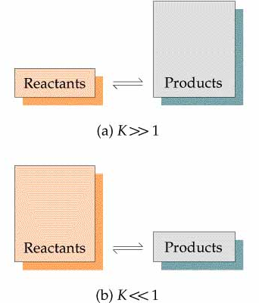
The Equilibrium Constant K
Notes:
In the equilibrium-constant expression the numerator is the product of the concentrations of the products each raised to the power of its coefficient in the balanced equation divided by the product of the concentration of the reactants each raised to the power of its coefficient. Consequently when K >> 1 there are more products present at equilibrium and when K << 1, there are more reactants present at equilibrium.

Slide 34
Calculating Equilibrium Constants
Tabulate 1) initial and 2) equilibrium concentrations (or partial pressures).
Having both an initial and an equilibrium concentration for any species, calculate its change in concentration.
Apply stoichiometry to the change in concentration to calculate the changes in concentration of all species.
Deduce the equilibrium concentrations of all species.

Slide 35
CH₃COOC₂H_{5(aq)} + H₂O_{(aq)} CH₃COOH_{(aq)} + C₂H₅OH _{(aq)}
K_{c}:
5.00 ml of ethyl alcohol, 5.00 ml of acetic acid and 5.00 ml of 3M hydrochloric acid were mixed in a vial and allowed to come to equilibrium. The equilibrium mixture was titrated and found to contain 0.04980 mol of acetic acid at equilibrium. What is the value of K_{c} ?
1) Calculate the initial molar concentrations (moles are OK in this case).
2) Use the equilibrium concentration of acetic acid to determine the changes and the equilibrium concentrations of the others.
3) Place the equilibrium values into the equilibrium expression to find it’s value.
CH₃COOC₂H_{5(aq)} + H₂O_{(aq)} CH₃COOH_{(aq)} + C₂H₅OH _{(aq)}
Initial (mol)
Change
Equilibrium
0 0.261 0.0873 0.0856
+0.0375 +0.0375 -0.0375 -0.0375
0.0375 0.2985 0.0481
0.0498
0.0873 - 0.0498 = 0.0375
K_{c} = 0.214

Slide 36
Calculating Equilibrium Constants
1) Write the Equilibrium Expression for the hydrolysis of ethyl acetate and calculate K_{c} from the following equilibrium concentrations.
2) Write the Equilibrium Expression for the formation of ethyl acetate from acetic acid and calculate K_{c} from the following equilibrium concentrations.
Ethyl acetate = 0.01217 M; Ethanol = 0.01623 M
Acetic acid = 0.01750 M ; Water = 0.09267 M

Slide 37
Calculating K_{c} from Concentration Data
4.00 mol HI was placed in a 5.00 L vessel at 458°C, the equilibrium
mixture was found to contain 0.442 mol I₂. What is the value of K_{c} ?
Calculate the molar concentrations, and put them into
the equilibrium expression to find it’s value.
2 HI_{(g)} H_{2 (g)} + I_{2 (g)}
Starting conc. of HI =
4.00 mol
5.00 L
= 0.800 M
0.442 mol
5.00 L
Equilibrium conc. of I₂ =
= 0.0884 M
Conc. (M) 2HI_{(g)} H_{2 (g)} I_{2 (g)}
Starting 0.800 0 0
Change - 2x x x
Equilibrium 0.800 - 2x x x = 0.0884

Slide 38
Calculating K_{c} from Concentration Data
(continued)
2 HI_{(g)} H_{2 (g)} + I_{2 (g)}
[HI] = M = (0.800 - 2 x 0.0884) M = 0.623 M
[H₂] = x = 0.0884 M = [I₂]
[H₂] [I₂]
( 0.0884)(0.0884)
K_{c} = = = 0.0201
[HI]²
(0.623)²
What does the value 0.0201 mean? Does the decomposition proceed
very far under these temperature conditions?
Note: The initial concentrations, and one at equilibrium were provided. The others that were needed to calculate the equilibrium constant were deduced algebraically.

Slide 39
Calculation of Equilibrium Concentrations
The same steps used to calculate equilibrium constants are used.
Generally, we do not have a number for the change in concentrations line.
Therefore, we need to assume that x mol/L of a species is produced (or used).
The equilibrium concentrations are given as algebraic expressions.Solution of a quadratic equation may be necessary.

Slide 40
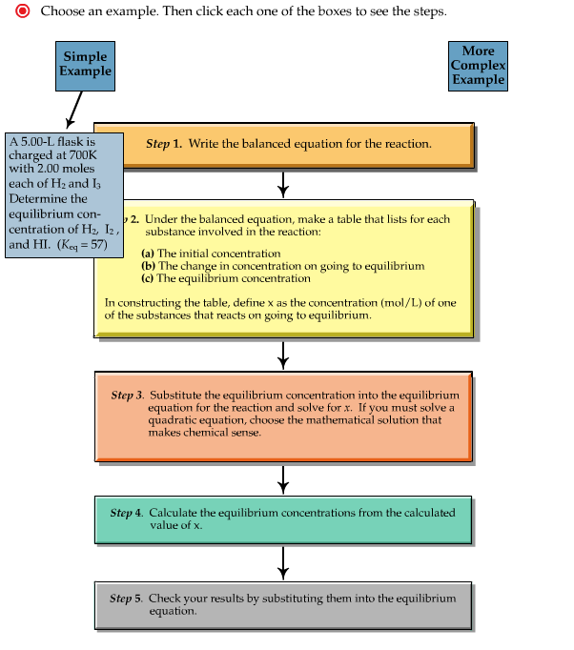
If you are interested in this interactive Flash tool, send Dr. R. an e-mail and he will send it you as an attachment.
http://chemconnections.org/general/chem120/UsinganEquilibriumTableII.swf

Slide 41
QUESTION
The weak acid HC₂H₃O₂, acetic acid, is a key component in vinegar. As an acid the aqueous dissociation equilibrium could be represented as
HC₂H₃O₂(aq)  H⁺(aq) + C₂H₃O₂ –(aq).
At room temperature the K_{c} value, at approximately 1.8 × 10^{–5}, is not large. What would be the equilibrium concentration of H⁺ starting from 1.0 M acetic acid solution?
1.8 × 10^{–5} M
4.2 × 10^{–3} M
9.0 × 10^{–5} M
More information is needed to complete this calculation.

Slide 42
ANSWER
B) is correct assuming that 1.0 – X can be approximated to 1.0. The relatively small value for K indicates that, compared to 1.0, X would not be large enough to include in the calculation. The equilibrium expression could be simplified to K = X²/1.0. A quick test of this hypothesis could be made by using the 4.2 × 10^{–3} value as X and checking the right side of the expression to see if it was the same as 1.8 × 10^{–5}.

Slide 43
Equilibrium Concentration Calculations from Initial Concentrations and K_{c}
The reaction to form HF from hydrogen and fluorine has an equilibrium
constant of 115 at temperature T. If 3.000 mol of each component
is added to a 1.500 L flask, calculate the equilibrium concentrations of
each species.
H_{2 (g)} + F_{2 (g)} 2 HF_{(g)}
Solution:
3.000 mol
[H₂] = = 2.000 M
1.500 L
[HF]²
K_{c} = = 115
3.000 mol
[H₂] [F₂]
[F₂] = = 2.000 M
1.500 L
3.000 mol
[HF] = = 2.000 M
1.500 L

Slide 44
Equilibrium Concentration Calculations
H_{2 (g)} + F_{2 (g)}  2 HF_{(g )}
(Continued)
Concentration (M) H₂ F₂ HF
__________________________________________
Initial 2.000 2.000 2.000
Change -x -x +2x
Final 2.000-x 2.000-x 2.000+2x
[HF]²
(2.000 + 2x)²
(2.000 + 2x)²
K_{c} = = 115 = =
[H₂][F₂]
(2.000 - x)
(2.000 - x)
(2.000 - x)²
Taking the square root of each side:
(2.000 + 2x)
x = 1.528
(115)^{1/2} = =10.7238
(2.000 - x)
[HF]²
(5.056 M)²
[H₂] = 2.000 - 1.528 = 0.472 M
K_{c} = =
[H₂][F₂]
(0.472 M)(0.472 M)
[F₂] = 2.000 - 1.528 = 0.472 M
[HF] = 2.000 + 2(1.528) = 5.056 M
check:
K_{c} = 115

Slide 45
Using the Quadratic Equation to solve for an unknown
The gas phase reaction of 2 moles of CO and 1 mole of H₂O in a 1L vessel:
Concentration (M) CO_{(g)} + H₂O_{(g)} CO_{2(g)} + H_{2(g)}
Initial 2.00 1.00 0 0
Change -x -x +x +x
Equilibrium 2.00-x 1.00-x x x
[CO₂][H₂]
(x) (x)
x²
K_{c} = = = = 1.56
[CO][H₂O]
(2.00-x)(1.00-x)
x² - 3.00x + 2.00
We rearrange the equation: 0.56 x² - 4.68 x + 3.12 = 0
ax² + bx + c = 0
quadratic equation:
- b + b² - 4ac
2a
x =
[CO] = 1.27 M
[H₂O] = 0.27 M
[CO₂] = 0.73 M
[H₂] = 0.73 M
4.68 + (-4.68)² - 4(0.56)(3.12)
x = = 7.6 M
and 0.73 M
2(0.56)

Slide 46
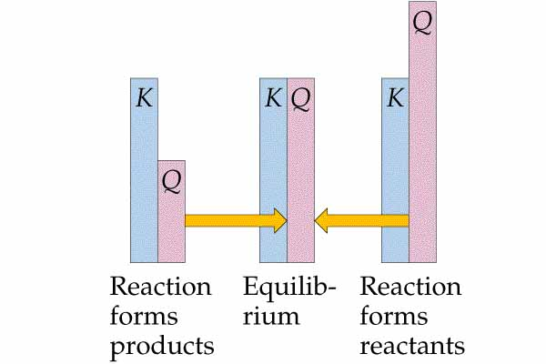
Reaction Quotient (Q) vs. K
Notes:
The reaction quotient Q is defined the same way as the equilibrium constant, except that the concentrations for Q are not necessarily equilibrium concentrations. When Q = K the system is at equilibrium. When Q > K the reaction will form more reactants as it approaches equilibrium and when Q < K the reaction will form more products as it approaches equilibrium.

Slide 47
K vs. Q: Equilibrium Constants
Has equilibrium been reached?
Has equilibrium been reached? Q is the “reaction quotient” for any general reaction, for example:
aA + bB mM + pP
[A], [B], [P], and [M] are Molarities at any time.
Q = K only at equilibrium

Slide 48
Q vs. K: Predicting the Direction of Reaction
If Q < K then the forward reaction must occur to reach equilibrium. (i.e., reactants are consumed, products are formed, the numerator in the equilibrium constant expression increases and Q increases until it equals K).
If Q > K then the reverse reaction must occur to reach equilibrium (i.e., products are consumed, reactants are formed, the numerator in the equilibrium constant expression decreases and Q decreases until it equals K).

Slide 49
Calculating Reaction Direction and
Equilibrium Concentrations
Two components of natural gas can react according to the
following chemical equation:
CH_{4(g)} + 2 H₂S_{(g)} CS_{2(g)} + 4H_{2(g)}
1.00 mol CH₄, 1.00 mol CS₂, 2.00 mol H₂S, and 2.00 mol H₂ are mixed in a 250 mL vessel at 960°C. At this temperature, K_{c} = 0.036.
(a) In which direction will the reaction go?
(b) If [CH₄] = 5.56 M at equilibrium, what are the concentrations of the other substances?
Calculate Q_{c} and compare it with K_{c}. Based upon (a), we determine the sign of each component for the reaction table and then use the given [CH₄] at equilibrium to determine the others.
Solution:
[H₂S] = 8.00 M, [CS₂] = 4.00 M
and [H₂ ] = 8.00 M
1.00 mol
0.250 L
[CH₄] = = 4.00 M

Slide 50
Calculating Reaction Direction and
Equilibrium Concentrations
[CS₂] [H₂]⁴
4.00 x (8.00)⁴
Q_{c} = = = 64.0
[CH₄] [H₂S]²
4.00 x (8.00)²
Compare Q_{c} and K_{c}: Q_{c} > K_{c} (64.0 > 0.036, so the reaction goes to the left. Therefore, reactants increase and products decrease their concentrations.
(b) Set up the reaction table, with x = [CS₂] that reacts, which equals the [CH₄] that forms.
Concentration (M) CH_{4 (g)} + 2 H₂S_{(g)} CS_{2(g)} + 4 H_{2(g)}
Initial 4.00 8.00 4.00 8.00
Change +x +2x -x -4x
Equilibrium 4.00 + x 8.00 + 2x 4.00 - x 8.00 - 4x
Solving for x at equilibrium: [CH₄] = 5.56 M = 4.00 M + x
x = 1.56 M

Slide 51
Calculating Reaction Direction and
Equilibrium Concentrations
x = 1.56 M = [CH₄]
Therefore:
[H₂S] = 8.00 M + 2x = 8.00 M + 2(1.56 M) = 11.12 M
[CS₂] = 4.00 M - x = 4.00 M - 1.56 M = 2.44 M
[H₂] = 8.00 M - 4x = 8.00 M - 4(1.56 M) = 1.76 M
[CH₄] = 1.56 M

Slide 52
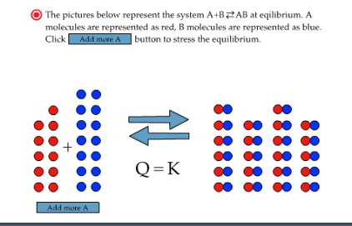
Le Châtelier’s Principle
. . . if a change is imposed on a system at equilibrium, the position of the equilibrium will shift in a direction that tends to reduce that change.

Slide 53
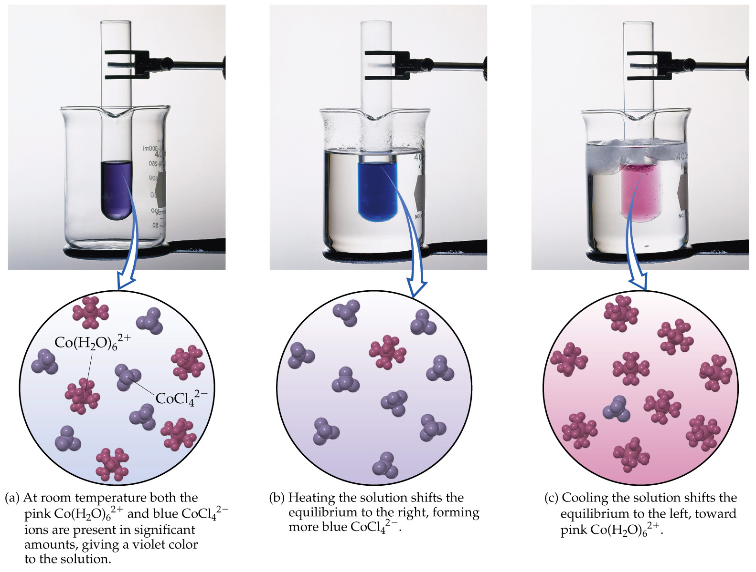

Le Châtelier’s Principle

Slide 54
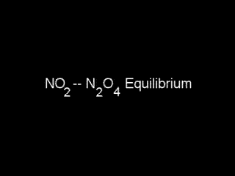
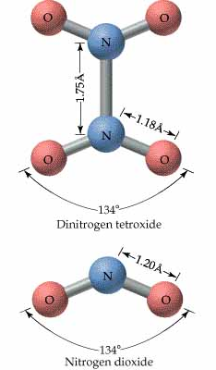
NO₂ - N₂O₄
Notes:
The red-brown gas NO₂ exists in equilibrium with colorless N₂O₄. When a tube containing the equilibrium mixture is put into hot water, the equilibrium is shifted in the direction of NO₂ so more of the reddish-brown gas is present. As the temperature is decreased the equilibrium shifts in favor of colorless N₂O₄. The color fades when the tube is placed in an ice bath and NO₂ is converted to N₂O₄.

Slide 55
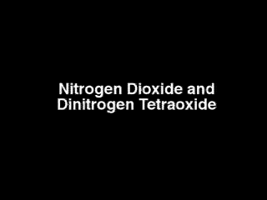
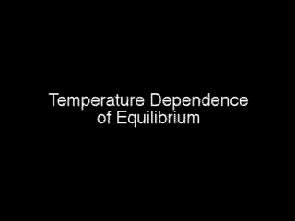
Temperature Dependence of K
Notes:
In a closed container the reddish-brown gas NO₂ is in equilibrium with the colorless gas N₂O₄. According to Le Chatelier's principle when the temperature of an equilibrium system is increased at constant volume the equilibrium shifts in the direction that absorbs heat. Since the conversion of 2NO₂ to N₂O₄ is an exothermic reaction, the equilibrium shifts in favor of NO₂ when the temperature is increased from 373 K to 473 K.

Slide 56
Changes on the System
1. Concentration: The system will shift concentrations away from the added component. K remains the same.
2. Temperature: K changes depending upon the reaction.
If endothermic, heat is treated as a “reactant”, if exothermic, heat is a “product”. Endo- > K increases; Exo- > K decreases.
if ΔH > 0, adding heat favors the forward reaction,
if ΔH < 0, adding heat favors the reverse reaction.

Slide 57
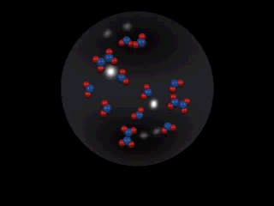
Chemical Equilibrium

Slide 58
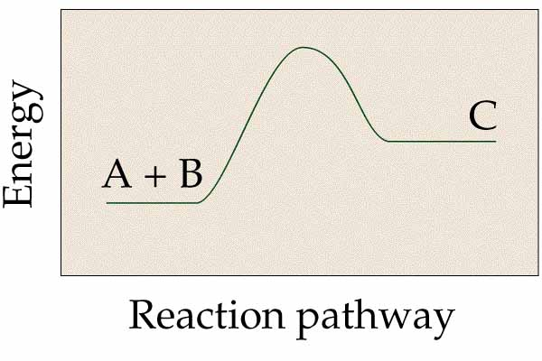
Which is favored by raising the temperature in the following equilibrium reaction? A+B or C
Notes:
The student is asked several questions about the energy profile of the reaction presented in this figure.

Slide 59
QUESTION
The following table shows the relation between the value of K and temperature of the system:
At 25°C; K = 45; at 50°C; K = 145; at 110°C; K = 467
(a) Would this data indicate that the reaction was endothermic or exothermic? (b) Would heating the system at equilibrium cause more or less product to form?
Exothermic; less product
Exothermic; more product
Endothermic; less product
Endothermic; more product

Slide 60
ANSWER
D) makes correct assumptions using Le Châtelier’s principle. The increase in K with temperature indicates that the reaction uses energy to produce a higher ratio of product to reactant at equilibrium. The stress of heat for an endothermic reaction causes more product to form.

Slide 61
Changes on the System (continued)
3. Pressure:
a. Addition of inert gas does not affect the equilibrium position.
b. Decreasing the volume shifts the equilibrium toward the side with fewer moles.
K_{p} = K_{c} (RT)^{Δn}
Δn = n_{gas} (products) - n_{gas} (reactants)
As the volume is decreased pressure increases.
Le Châtelier’s Principle: if pressure is increased the system shifts to minimize the increase.

Slide 62
QUESTION
The balanced equation shown here has a K_{p} value of 0.011. What would be the value for K_{c} ?(at approximately 1,100°C)
2H₂S(g)  2H₂(g) + S₂(g)
0.000098
0.011
0.99
1.2

Slide 63
Answer
A) is obtained from K_{p} = K_{c}(RT)^{Δn} when T is expressed in K and the expression is solved for K_{c}

Slide 64
Changes on the System (continued)
4. The Effect of Catalysts
A catalyst lowers the activation energy barrier for any reaction….in both forward and reverse directions!
A catalyst will decrease the time it takes to reach equilibrium.
A catalyst does not effect the composition of the equilibrium mixture.

Slide 65
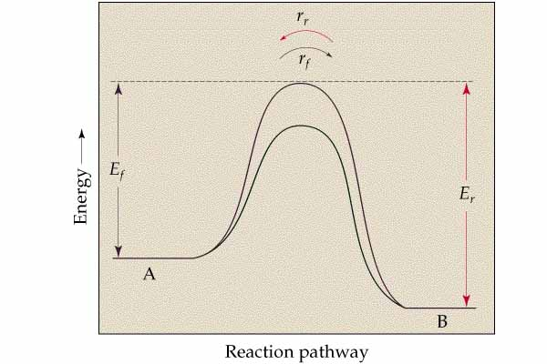
Energy vs. Reaction Pathway
Notes:
A catalyst lowers the activation energy barrier of a reaction. This diagram shows that the catalyst lowers the activation energy for the forward and reverse reactions by the same amount. Consequently a catalyst does not affect the position of the equilibrium but it does speed up the rate at which equilibrium is reached.

Slide 66
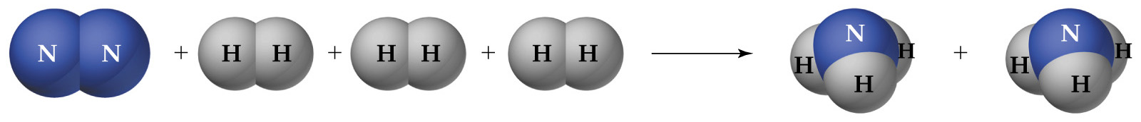
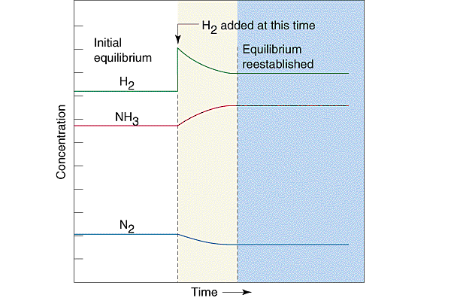
Putting it all Together

Slide 67
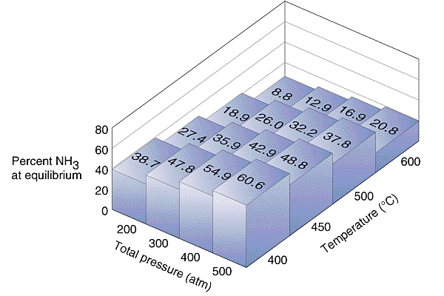
Putting it all Together

Slide 68
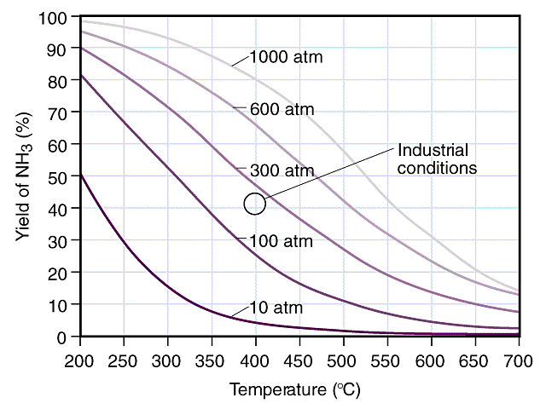
Putting it all Together

Slide 69
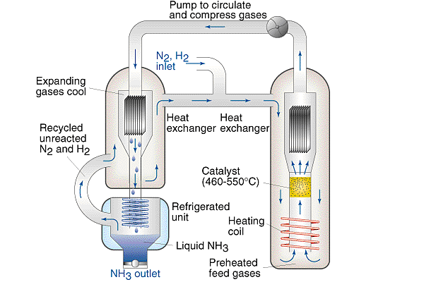
Putting it all Together

